Slide 1

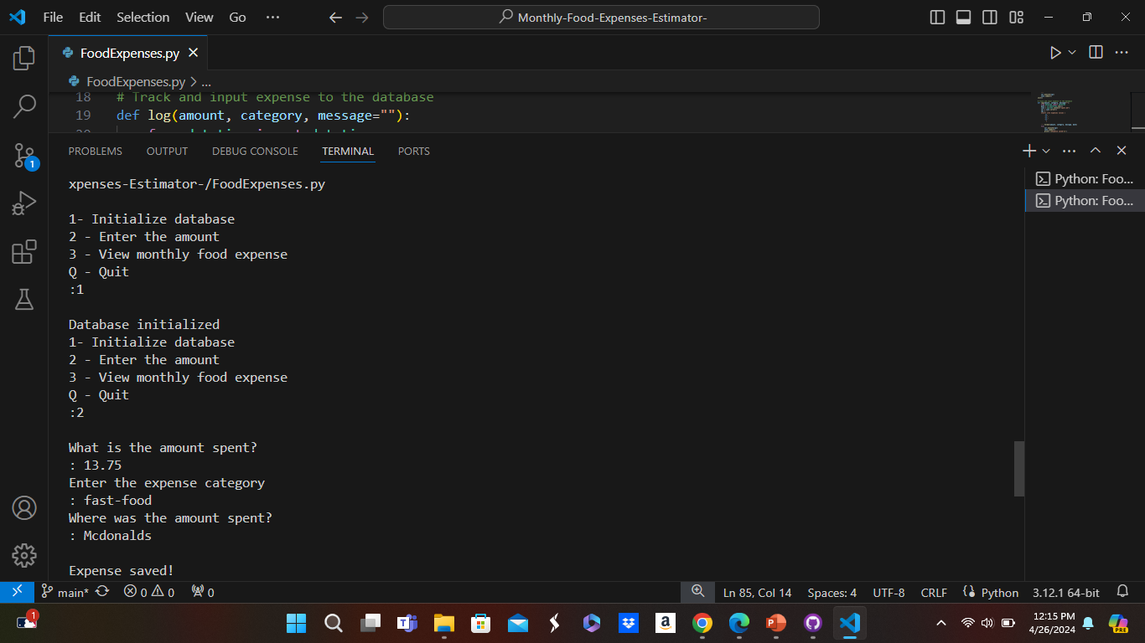
Monthly Food Expenses Estimator
The program will track the input the user has given such as the amount spent on food and the category with the name of places, they have visited then calculate how much was spent in a month
By: Daryl Boddie
https://github.com/ksu-is/Monthly-Food-Expenses-Estimator-/tree/main

